Slide 1
Open House 2016
Mrs. Knowles
Life Science

Slide 2
Welcome
About Me
Teaching science for 12 years
1st time in 7th grade
Just moved to Gainesville from Michigan
About the classroom
Supplies are available during class.
Absent Folders for each class.
Turn in Trays
Workbooks and Textbooks are available.

Slide 3
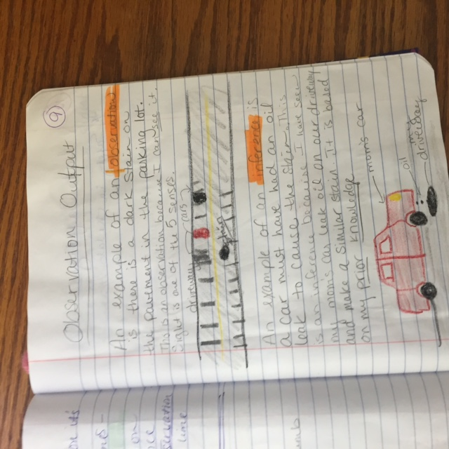
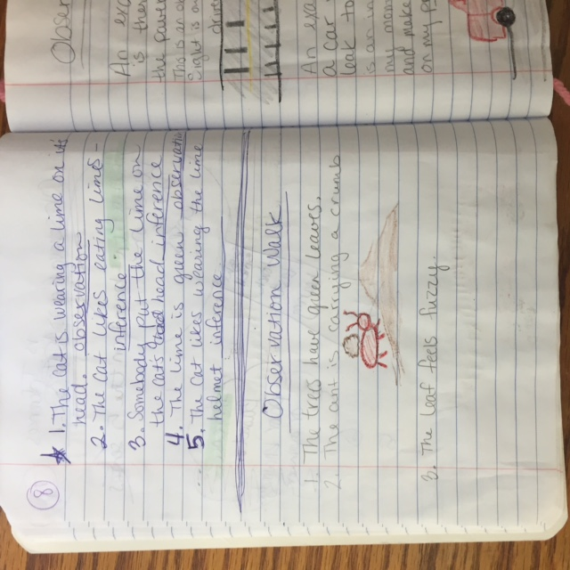
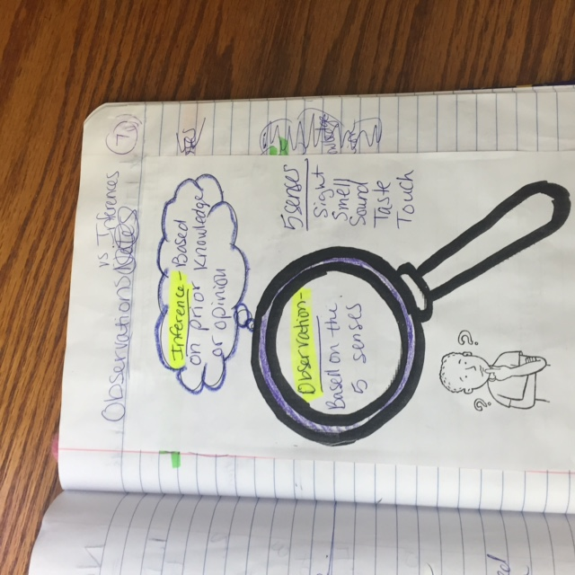
Interactive Notebooks
Students are using interactive notebooks. Most of the time, they will stay in the classroom.

Slide 4
Homework
Assigned the first day of the week.
Due Thursdays.
We go over the homework in class.
Will not require a textbook.

Slide 5
Grades
I try to update grades weekly.
Students may make up missing work for each unit until the end of the unit.
Please e-mail me if there is a concern about missing work.
The notebooks will be graded this weekend which will change grades quite a bit.
Students have had multiple opportunities to finish and/or fix things in their notebooks.

Slide 6
Communication
E-mail is the best way to get ahold of me.
I will respond within 24 hours normally.
knowlesja@gm.sbac.edu

Slide 7
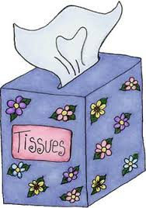
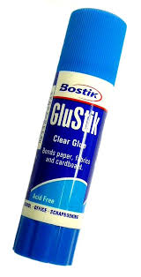
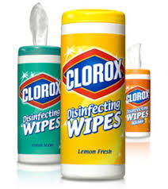
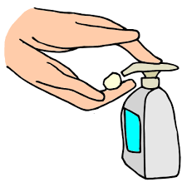
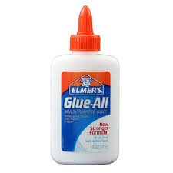
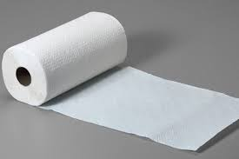
Supplies – If you would like to contribute….
Tissues, Lysol or Clorox wipes and hand sanitizer
Paper towels
Glue
Paper – lined, computer and/or colored computer paper

Slide 8
Website
www.mrsknowlesscience.weebly.com
Just started
Will have posts including what we do in class each week.
Will have links to handouts for downloading or printing of missing work.

Slide 9
Questions?

